Slide 1
Pattern-of-life Analysis and Deviations for Bluetooth and
Bluetooth Low Energy Devices
Alexander Armstrong, Seth Bedford, Troy Frazier, Vishal Madipadga, James Wei, Evelyn Wong

Slide 2
Outline
Introduction and Motivation
Problem Statement
Goals
Approach
  Ubertooth One Capture
  Identifying Packets
Issues Encountered
Solutions
Results
Future Work

Slide 3

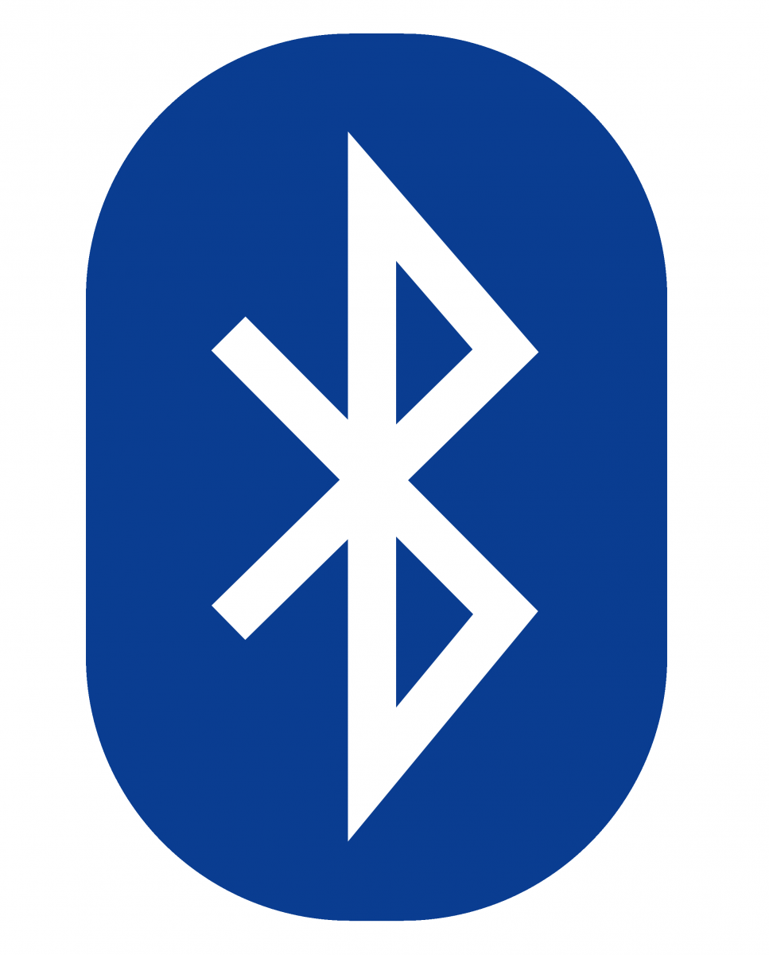
Introduction and Motivation
IOT has exploded in the last decade
Billions of devices now connected to the internet
Little to no security considerations are taken
Opens the opportunity for malicious actors to gain unauthorized access to a system through bluetooth devices
Aim to monitor and detect abnormal bluetooth behavior
Notes:
Example: Majority of bluetooth communication is done in plaintext

Slide 4
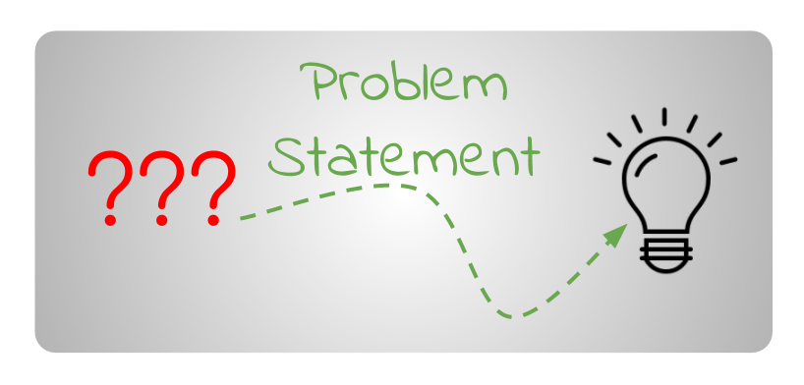
Problem Statement
How can we detect a malicious device utilizing bluetooth communications as a primary means of attack?
How can we create a model to separate benign devices from malicious or abnormally behaving devices?
How can we use such a model to either protect from any such attacks or at least warn defenders that such an attack is occuring?
Notes:
Example: Majority of bluetooth communication is done in plaintext

Slide 5
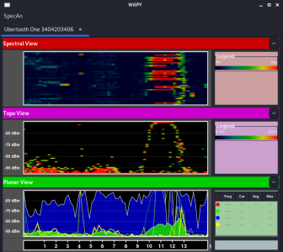
Goals
Capture and analyze bluetooth packets to develop a pattern of life of bluetooth devices
Use gathered data to model whether a device is behaving normally or abnormally
Determine if a bluetooth device is acting maliciously based on the developed model
Machine learning models provide a promising strategy for creating a standard model of normal behavior

Slide 6
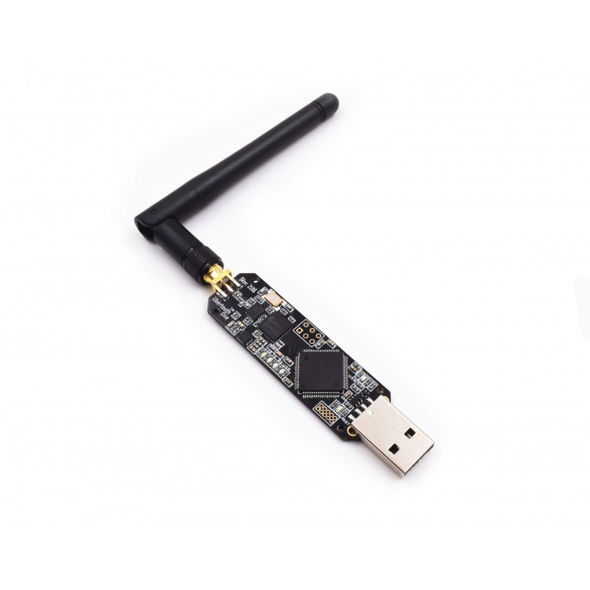
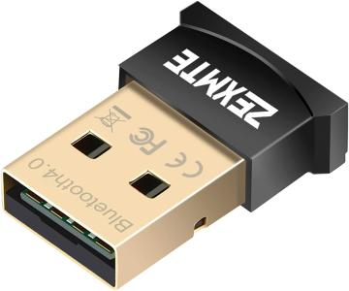
Approach - Capturing Packets
We set up a Linux VM for capturing wireless communications and used an Ubertooth One to begin sniffing packets. A small bluetooth receiver like shown below is also needed.
Our team purchased 3 different bluetooth devices and began to record the data transferred when connected to the devices
Devices used are as follows:
Samsung galaxy smartwatch
Samsung wireless headphones
Fitbit
Notes:
An Ubertooth one needs a bluetooth receiver to function
The Ubertooth can capture on a 2.4 GHz antenna
Total cost of all components around $150, a small cost for malicious users!

Slide 7
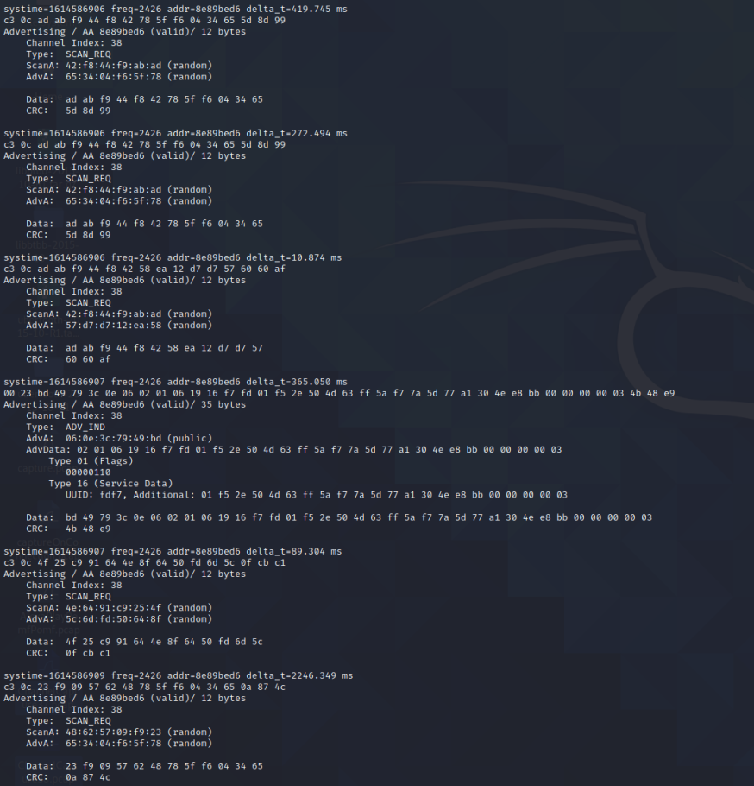
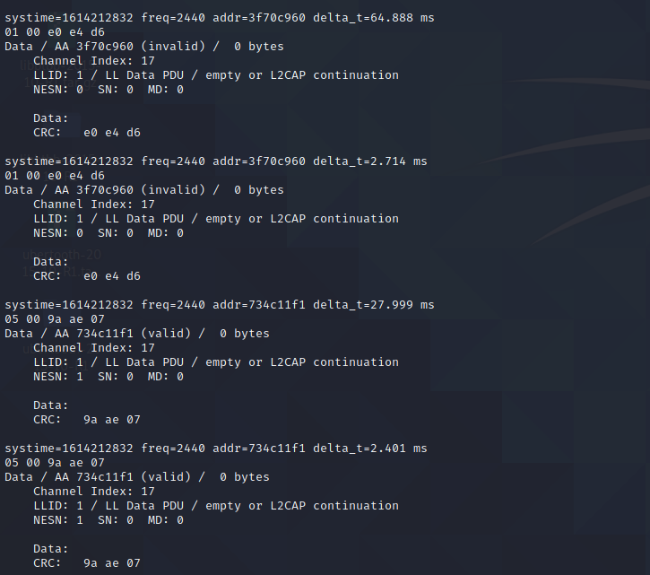
Example of Captured Traffic
Notes:
Here is an example of bluetooth traffic we were able to capture. On the left we have data packets and on the right we have advertising packets.

Slide 8
Approach - Identifying Packets
In the bluetooth protocol, advertising packets are used to identify a device
ADV_IND - a peripheral device requesting connection to a central device (ie: speakers to a phone)
ADV_DIRECT_IND - similar to above but directed to a specific central device (ie: wireless headphones to my phone)
ADV_NONCONN_IND - non connectable devices simply broadcasting
ADV_SCAN_IND - similar to ADV_NONCONN_IND but with more information upon scan request
ATT packets contain a GATT (Generic Attribute Profile) for a device
These store information about certain services and characteristics provided by a device
Notes:
One of our approaches is to identify packets that can help us establish a pattern-of-life for a particular bluetooth device. Put another way, extract features from certain packets that will allow us to uniquely identify a device.
Many of the packets we saw were advertising packets. There were 4 types of advertising packets we observed:
Advertising Indications Packets: These are packets that peripheral device sends to request a connection to any central device in the area (an example of a peripheral device would be a smart watch or speakers. An example of a central device is your smartphone)
Advertising Direct Indications Packets: There are packets that a peripheral device sends to request a connection to a specific central device
Advertising Nonconn indications: There are advertising packets that non-connectable devices advertise to any listening devices
Advertising Scan Indications Packets: These are similar to ADV_NONCONN_IND packets except they advertise
The specific advertising packet we focused on were adv_ind packets as the bluetooth devices we observed advertised using adv_ind packets. These packets also allowed us to see the average time interval between advertising packets which may be a potential feature we use
There are also ATT (which stands for attribute protocol) packets that contain a GATT (Generic Attribute Profile) for a device. A GATT stores services for provided by a device. These services are made up of characteristics. Bluetooth Special Interest Group has an official list of services and characteristics. An example of a service for a Fitbit may be a Heart Rate service which may be composed of a heart rate measurement characteristic.

Slide 9

Notes:
Bluetooth low energy uses 40 2MHz channels
3 of the channels are primary advertising channels, these are channels 37, 38, and 39. The other 37 are secondary advertising channels, also known as data channels
Packet identifiers such as type of advertising packet and channel shown outlined in red along with the bytes captured

Slide 10
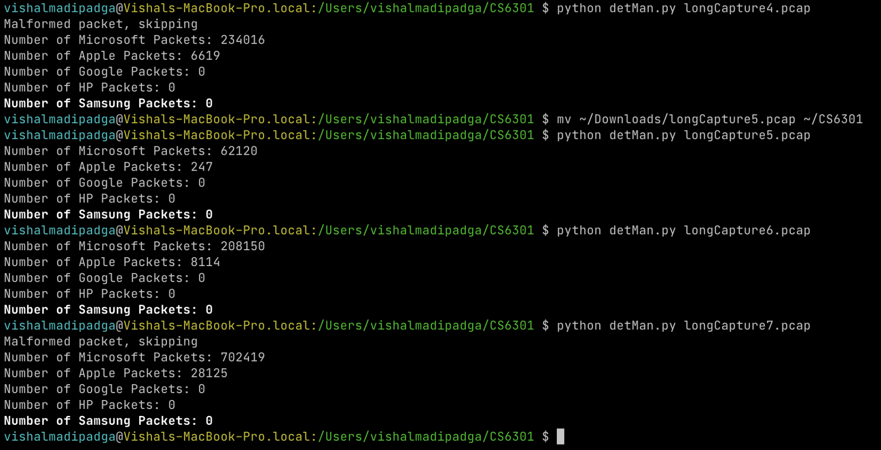
Approach - Analysis
We were able to determine the origins of the captured packets through a manufacturer flag within the packet itself
Shown below is an example of the different packets we captured

Slide 11
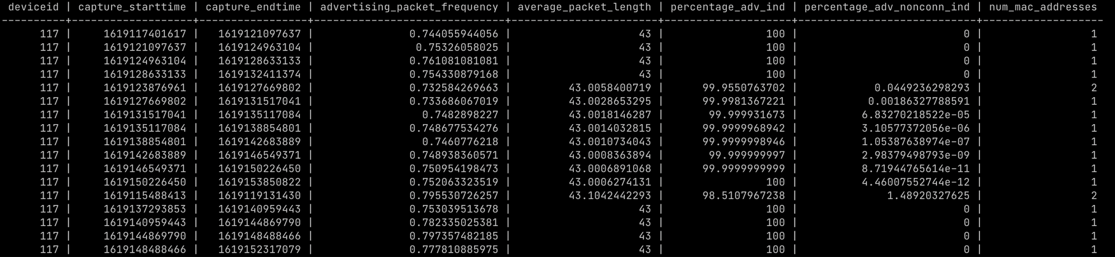
Pattern-Of-Life Database
Built a database for the bluetooth device we were analyzing
The database had two tables, an Advertising table and a Data table
The Data table was to store information about the generic attribute profile (GATT) found in ATT packets
  Each column would correspond to a service or characteristics of a service
  Unable to capture ATT packets
The Advertising table stored statistics about the advertising packets
  Each row corresponded to an hour of packet capture
  Columns
    Advertising packet frequency, average packet length, percentage of each type of advertising packet, and number of mac addresses used

Slide 12
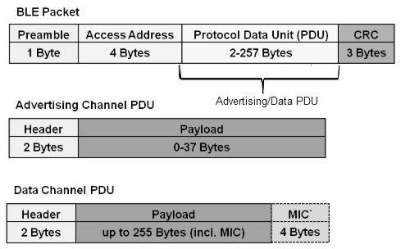
Issues Encountered
Difficulty in capturing the correct identifying packets, specifically ATT packets
Some devices send advertising packets, some only send on first connection, others will never send
Reasonable to assume a malicious actor may not send advertising packets or only send altered packets

Slide 13
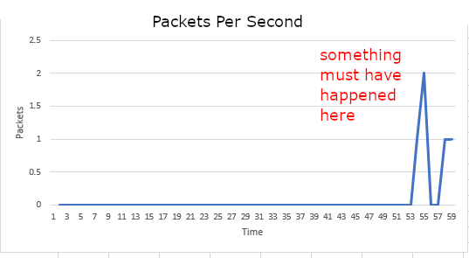
Solutions
Use packet density to determine device behavior
Use presence of advertising packets to determine if a device is connected
The assumption is that the same behavior will use the same packets, and thus show the same graph

Slide 14
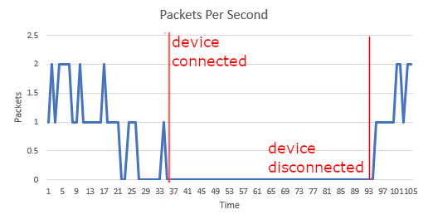
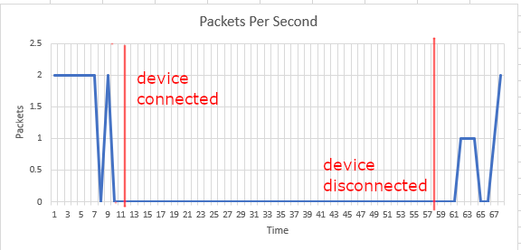
Results
Graphs indicate connection profile of bluetooth devices
Devices send a flurry of advertising packets when attempting to connect, and then zero after a successful connection
  We can identify devices that have successfully connected based on this profile
Devices that never successfully connect may be suspicious

Slide 15
Future Work
Provenance
  Single based event threat detection leads to tons of false alarms
  Consider the context (forward and backward)
  Rareness of event graph = high likelihood of actual threat
  Frequency of events stored in a database of known benign activity
  Application of ML when classifying paths of provenance graph to determine maliciousness (doc2vec)

Slide 16

Questions?

